Slide 1
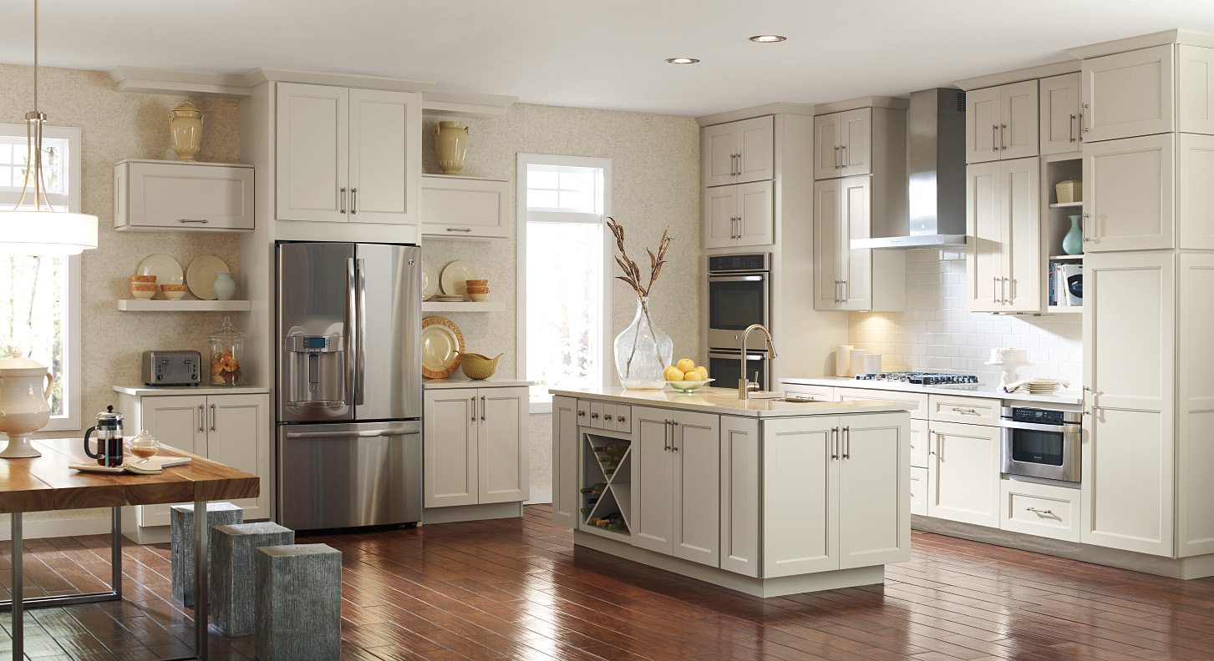

Features / Benefits
February 2018

Slide 2
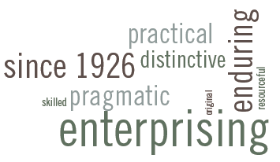
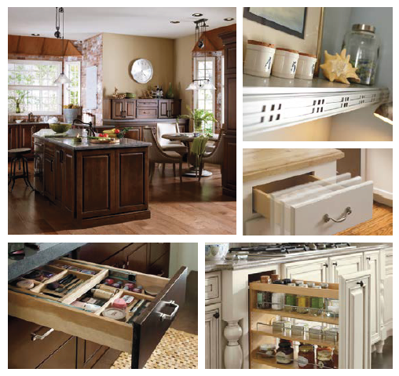
WHY KEMPER? | Overview
Kemper is the perfect balance of beauty, strength and function, making it the best overall value in the industry
Founded in 1926, with more than 90 years of experience providing cabinetry solutions
Manufactured and Shipped from Grants Pass, OR; Arthur, IL; and Auburn, AL
Full semi-custom line with broad SKU offering and modifications, ensuring ample design flexibility for nearly any project
Validated color palette to address current consumer preferences
No charge Express Response program
ESP - Environmental Stewardship Program Certified
Limited Lifetime Warranty
Notes:
Kemper is a full semi-custom line of cabinetry focused on quality, intelligent design and style
Modifications available, allowing design flexibility of almost any space
Moderately priced
Meets and exceeds KCMA tests for durability
Backed by a limited lifetime warranty

Slide 3
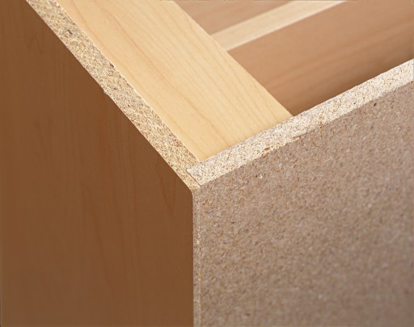
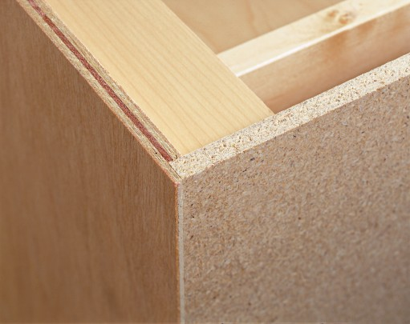
CONSTRUCTION | Sides
FEATURES
BENEFITS
    Choice:
    1/2” Thick Furniture Board with Matching Laminate Exterior
    Plywood Ends & All Plywood Construction (APC):
    1/2” Thick Plywood with Unfinished Veneer Exterior
  Choice:
  Furniture board is extremely stable in environments with changing humidity
  Plywood Ends:
  Combines the benefits of furniture board and plywood construction
  APC:
  Plywood increases overall cabinet durability
Notes:
Choice Construction:
Furniture Board
Meets and exceeds KCMA’s rigorous standards for quality
Exterior Sides
Covered with a laminate material, resembling the cabinet finish selected
Sides are not wood veneer – won’t age in the same way as the doors and face frames
Plywood Ends* Construction: Upgrade from Trademark construction; sides change to plywood
Plywood Ends (PE)
Meets and exceeds KCMA’s rigorous standards for quality
Exterior Sides
Covered with an unfinished veneer; must order PE modification to match with cabinet face
All Plywood* Construction (APC): Upgrade from Plywood Ends
Plywood throughout the Cabinet
Meets and exceeds KCMA’s rigorous standards for quality
Exterior Sides
Covered with an unfinished plywood; must order PE modification to match with cabinet face
* All plywood components meet ANSI/HPVA HP-1 standards, and may contain MDF or particleboard.

Slide 4
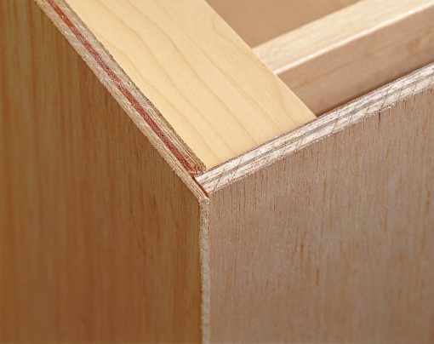
CONSTRUCTION | Back
FEATURES
BENEFITS
Choice &
Plywood Ends:
  Solid 3/8” Furniture Board
APC:
  Solid 3/8” Plywood Construction
Back:
3/8” solid back creates superior durability
Load-bearing back fully supports the weight of cabinet contents, without worry of separation from the wall
Shown: APC - Solid Back
Notes:
Solid 3/8” Load Bearing Back allows for:
Distributing cabinet weight along multiple points of contact when installed
Cabinet installed through multiple locations on the cabinet back, rather than only through hang rail
Solid back meets and exceeds all KCMA testing standards for the load bearing capabilities, when installed properly
Base cabinets have a 3mm system holes for easy drawer & tray installation.

Slide 5
CONSTRUCTION | Shelving & Butt Doors
FEATURES
BENEFITS
Wall Cabinets:
  Choice & Plywood Ends: Adjustable 3/4” Thick Furniture Board
  APC: Adjustable 3/4” Thick Plywood
  Base Cabinets:
    Choice & Plywood Ends: Adjustable 3/4” Thick Furniture Board, Half Depth
    APC: Adjustable 3/4” Thick Plywood, Half Depth
    Cabinet Interior for Standard and PE is Natural Maple laminate; APC is clear-coated veneer.
    Butt Doors:
    Standard on All Double Door Cabinets up to 36” Wide
  Shelving:
  3/4” thick shelving provides greater stability for your cabinet contents
  Adjustable wall shelving allows for customized storage space
  Butt Doors:
  Store large bowls and platters without having to maneuver around a center mullion
Notes:
Wall / Tall Cabinet Shelving:
30” and 36” high cabinets come with two adjustable shelves; 42” high cabinets come with three adjustable shelves
Sits behind face frame and full depth of interior of the cabinet
Same color as cabinet interior
Base Shelving:
Single adjustable 3/4” thick shelf that is 15” deep
Can be replaced with roll trays, either factory or field installed Butt Doors:
Greater accessibility with no obstruction into the cabinet opening

Slide 6
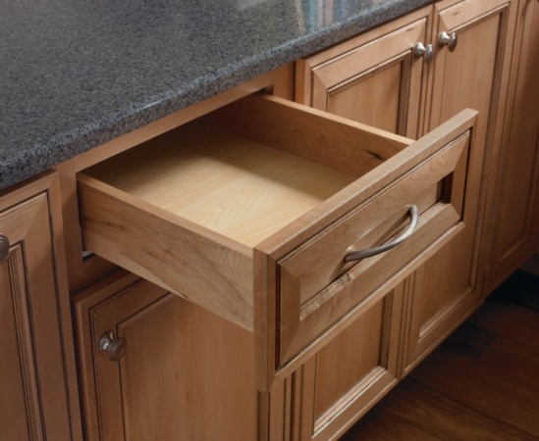
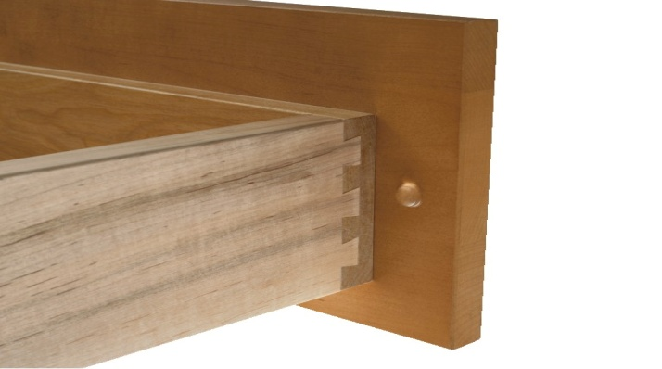
CONSTRUCTION | Drawer Box
FEATURES
BENEFITS
Choice,
Plywood Ends & APC:
  Four-Sided Box Construction
  Sides, Back & Front: 3/4” Nominal Thick All Wood
  Joint: Dovetail
Drawer Construction:
  3/4” thick material and dovetailed joinery create unparalleled durability
Notes:
Four sided construction stands up better to everyday wear and tear
Pulling on the drawer front does not cause it to separate from the box
Dovetail joint - stronger, to hold up against constant opening and closing of the drawer
Drawer bottom is fully captured by the sides of the box, preventing separation
Meets KCMA standards of weight capacity of 15 lbs per sq ft.

Slide 7
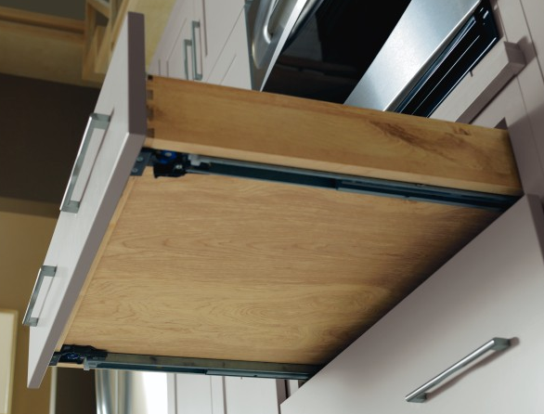
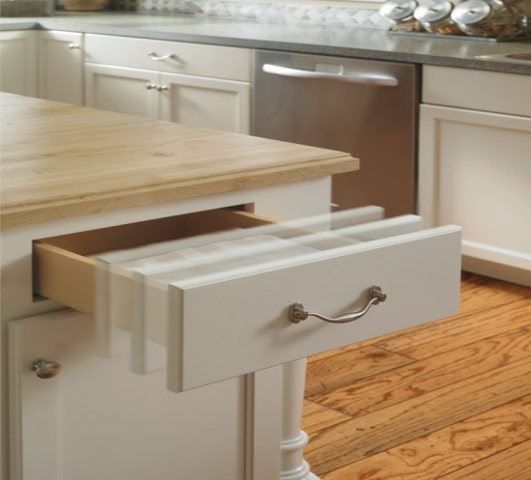
CONSTRUCTION | Drawer Guides
FEATURES
BENEFITS
Choice, Plywood Ends & APC:
  Double Fully Concealed, Roller Bearing, Self Aligning Full Extension Guides with Smart Stop™ Standard
  Fast Clip Removal System
  Drawer Guides:
  Full extension guides allow for greater accessibility into the drawer box
  Smart Stop™ allows drawer to shut slowly, to prevent slamming drawers
Notes:
Full Extension Drawer Guides with Smart Stop
Full extension drawer guides allow drawer to extend to face frame, for accessibility to all contents inside the drawer
Smart Stop prevents:
Slamming
Fingers from getting shut in the drawer

Slide 8
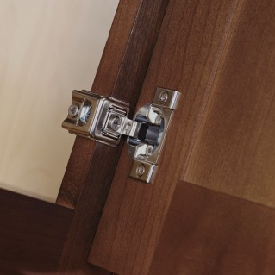
CONSTRUCTION | Hinges
FEATURES
BENEFITS
Choice, Plywood Ends & APC
Concealed, 6-Way Adjustable, Integrated Soft-Close Hinges Standard
Hinge also features a deactivation option
  Hinges:
  Concealed hinges create a more finished, up-to-date look
  Adjustability ensures proper door alignment
  Soft-Close prevents cabinet doors from slamming (can be adjusted or turned off)
Notes:
As humidity levels change in a household, cabinet doors can expand and contract; The end consumer may want to adjust their doors when this happens.
All doors have 6-way, fully concealed hinges and are adjustable up / down, left / right, and in / out. This can also help with the adjustment of the doors if improperly installed.
The Soft-Close feature is built into the hinge and can be deactivated with the flip of a small grey switch located on the hinge
Some cabinets utilize a 170° or 107° 4-way adjustable hinge.

Slide 9
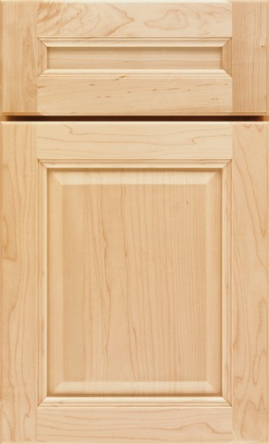
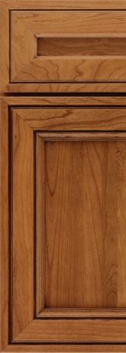
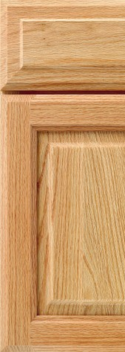
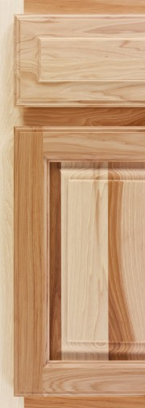
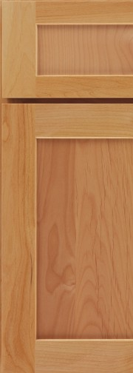
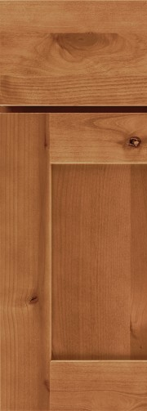
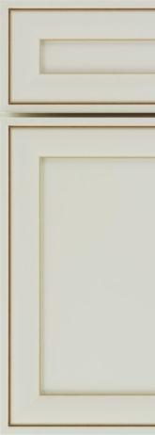
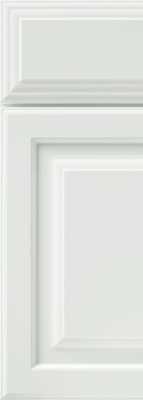
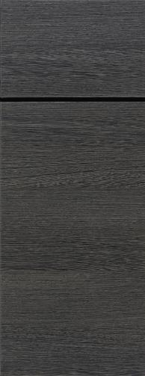
DOOR STYLES | Availability
Wide Selection of Door Styles:
Specialty Laminates
Maple
Cherry
Oak
PureStyle™ Laminate & Thermofoil
Hickory
Alder
Rustic Alder
Maple
Cherry
Oak
Hickory
Alder
Rustic
Alder
PureStyle™
Thermofoil
Specialty Laminate
Notes:
Great selection of door styles
Multiple wood species, Thermofoil, Specialty Laminates and PureStyle™

Slide 10
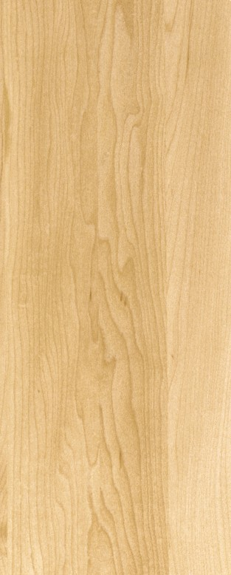
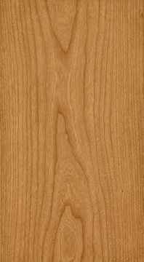
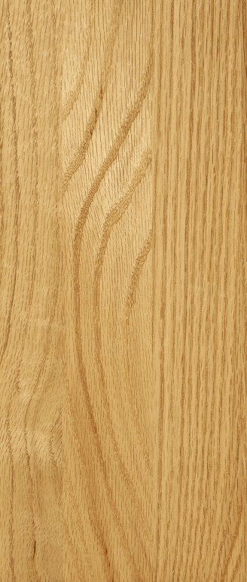
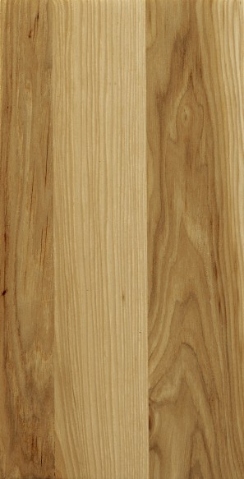
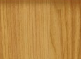
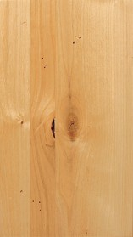
SPECIES & FINISHES | Lasting Beauty
FEATURES
BENEFITS
Offering:
Maple, Cherry, Oak, Hickory, Alder, Rustic Alder
Purestyle™, Thermofoil, and Specialty Laminates
Finishes:
Stains, Wood Tone Glazes, Opaques & the Opaque Glazes
Availability Varies by Wood Species
Finishes techniques:
Heirloom & Distressing
Wood species:
  Multiple wood species covering multiple price points
  Finishes:
  A wide selection of colors options to choose from to create your desired look
  Finish techniques:
  Heirloom & distressing techniques create a custom look for your space
Notes:
Maple
Subtle grain, uniform appearance, color ranges from creamy white to pale red / brown
May include bird’s eye dots and mineral streaks
Cherry
Color ranges from tan/blonde to deep brown, darkens naturally as it ages
Oak
Very strong, open grain pattern, color may vary from salmon red to dark cinnamon
May include random worm holes, knots and wild grain patterns, and mineral deposits of green, yellow or black
Hickory
Strong, dramatic grain pattern, color may change from blonde to tobacco brown
May include random worm holes and knots
Alder
Fine-grain, straight texture similar to cherry and maple
Softest of the hardwoods
Can have color and grain variations, tight pin knots are sometimes present
Rustic Alder
Light brown and reddish undertones
May contain pin holes, open knots, small cracks, bird pecks, mineral streaks and grain variations, some knots may have holes through the panel, larger holes will not be filled.
* When an Opaque finish or an Opaque Glaze finish is specified, the door and/or drawer front center panel may be constructed of Medium Density Fiberboard (MDF), except when Storm finish, Warwick and Lynville door styles, or when Distressing or Heirlooming are specified. MDF provides a smoother finish when painted, and is more resistant to warping, expansion, and contraction.

Slide 11
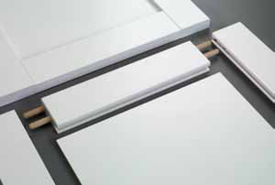
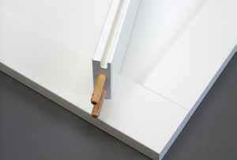
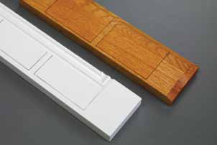
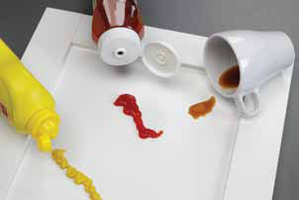
PURESTYLE™ | Durability
FEATURES
BENEFITS
Revolutionary New Material
  Environmentally Friendly, Nontoxic, Cellulose-Based
  Bridges the Gap Between Thermofoil & Painted Wood
True 5-Piece Door Construction
Fully Wrapped & Protected MDF Substrate
Dowel and Glued Joinery
  Appearance of paint without the cost
    Uniform color; consistency
    No cracking or peeling
  Crisp, clean detailing
    Color, design & style flexibility
  Maximum durability
    Minimal contraction / expansion
    Minimizes delamination
  Care & maintenance ease
    Resistant to stains & moisture
Notes:
PureStyle™:
Durable laminate material that provides superior abrasion resistance and meets/exceeds all KCMA performance standards
PureStyle™ is Laminate wrapped around door rails and panels and has a clear coat applied to it for durability
Rail and core material is MDF to ensure a consistent and stable product
Manufactured by MasterBrand Cabinets, Inc.

Slide 12
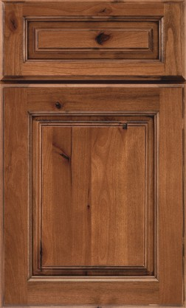
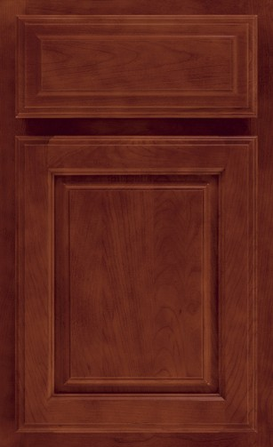
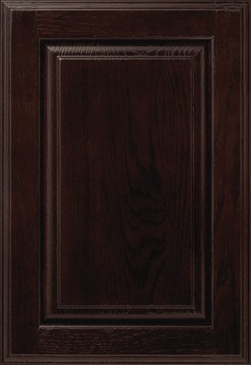
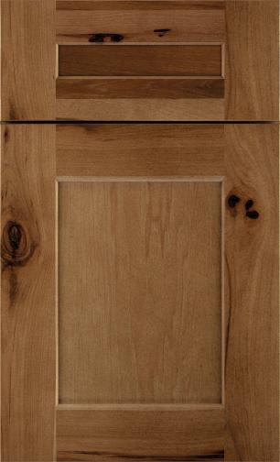
DOORS | Styling
FEATURES
BENEFITS
Full Overlay vs. Partial Overlay
Solid Wood vs. Wood Veneer
Recessed Center Panel vs. Raised Center Panel vs. Reversed Raised Center Panel
Square Profile vs. Arch Profile
  Broad assortment of combined features to give you numerous door styles from which to choose
  Wide breadth of styles to meet your taste
Notes:
Overlay refers to how much face frame shows when cabinet doors are closed
Full Overlay - Minimal face frame visible when the cabinet doors are closed; styled more like a piece of furniture
Partial Overlay - 1” cabinet face frame shows when doors are closed; considered a more “traditional” cabinet look
Solid Wood vs. Wood Veneer Center Panels
Stiles and rails of the door is always solid wood; center panel is the piece that will vary – solid or veneered
Solid – Offer more distinct profiling, more color variation
Veneer – More linear grain appearance, more uniform color
PureStyle and Thermofoil
Doors are made from MDF core
Solid durability
Square vs. Arch
Wall cabinets and the upper door of Tall cabinets only; base, office, and vanity cabinets will always have a square profile
All styles offered with square door profiles; some also offer an arch or cathedral profile

Slide 13
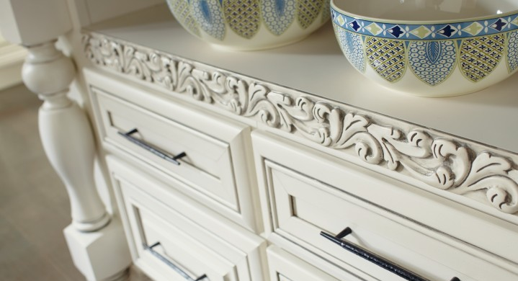
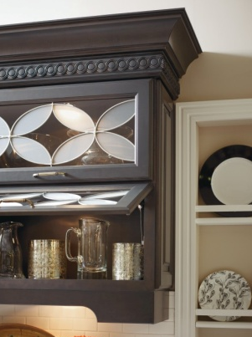
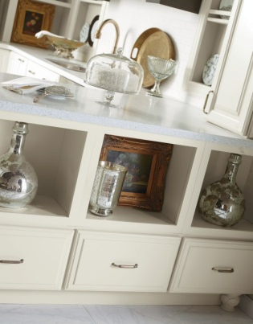
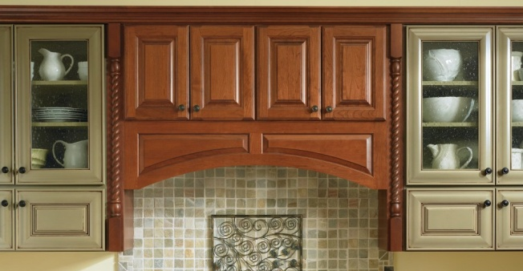
MOULDINGS & EMBELLISHMENTS | Decorative
FEATURES
BENEFITS
Including:
Top and Bottom Mouldings
Glass Door Inserts
Furniture Feet, Turnings, and Legs
Valances
Corbels, Rosettes, and Overlays
  Customize your space with stylized accents
  Accents available in styles from traditional to contemporary
  Highlight design elements
  Create a focal point or a furniture look
Notes:
The finishing pieces to any project
Personalization / customization

Slide 14
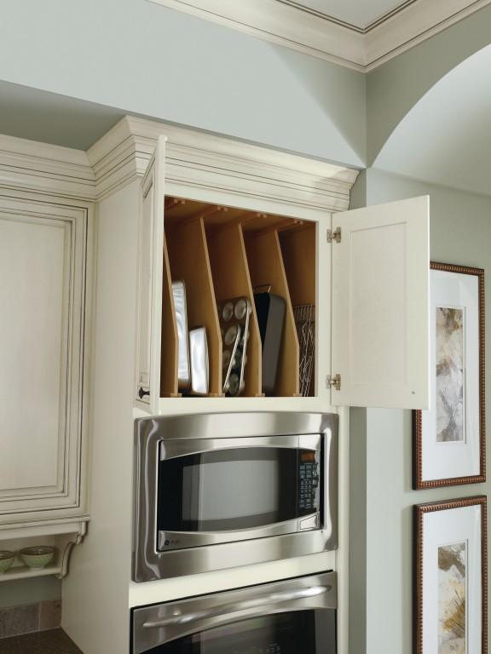
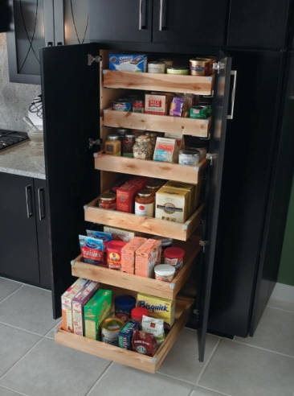
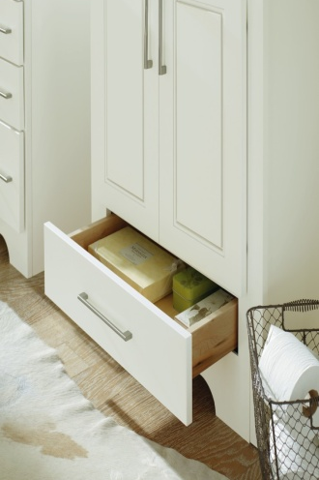
MODIFICATIONS| Performance
FEATURES
BENEFITS
Including:
Increased and Reduced Depth
Installed Tray Dividers, Roll Trays & Deep Roll Trays
Authentic Ends and Face Frame and Door On End
Matching Interior
Inverted Frame
Toekick Drawers and Toe Space Alteration
Many, Many More
  Maximize storage by adding storage where not possible before!
  Factory installed accessories save installation time and costs
  Customize your cabinets to fit your dimensions and your style
Notes:
Modifications - alterations applied to cabinetry, either as a group or to individual pieces, to customize to fit a specific use or environment
Can be applied to all types of cabinets: Wall, Tall, Base, Vanity and Office
Many are now No Charge Options, verify with the Price & Spec Book which modifications apply.

Slide 15
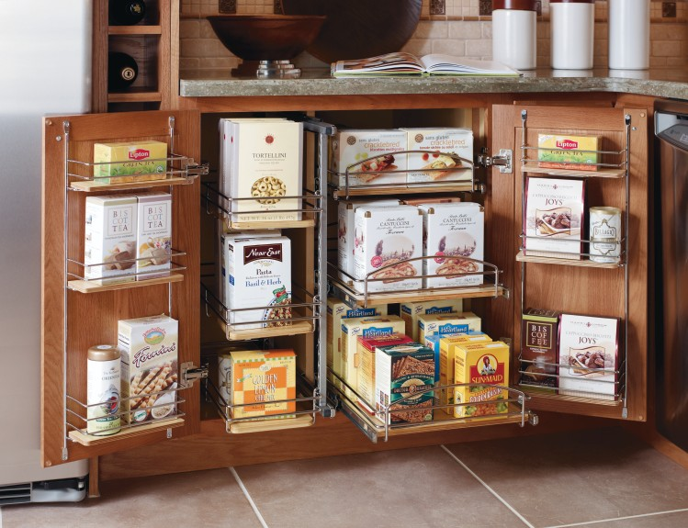
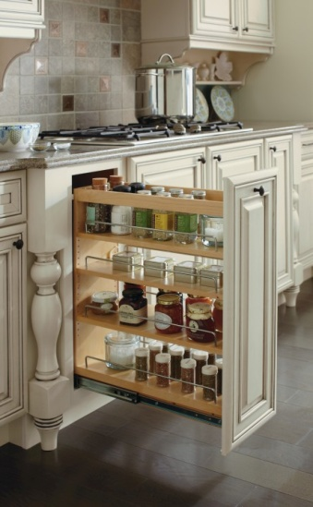
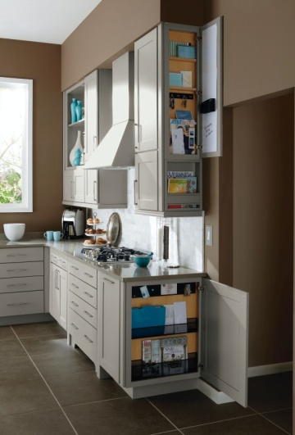
ORGANIZATION & ACCESSORIES | Storage
FEATURES
BENEFITS
Organizational cabinets include:
SuperCabinet™
Sink Base SuperCabinet™
Roll Trays and Pull- Outs
Wall and Base Message Center
Base Pots & Pans Pull-Out
Lazy Susans and Blind Corner Organization
Cutlery Dividers
  Amazing selection of organizational cabinets
  Increase accessibility into your cabinets
  Customize your space for your storage needs
  Use in kitchens, baths, offices, play rooms, or any room in the house
Notes:
Make the most of any space
Allow for great accessibility
Used in all rooms of the home

Slide 16

QUALITY | Warranty
FEATURES
BENEFITS
Lifetime Limited Warranty:
  Products Will Be Free From Defects in Material and Workmanship Under Normal Use
  Warranted to the Original Consumer for the Lifetime of the Kitchen*
  Environmental Stewardship Program:
Making Sure More Than Just Your Cabinets Last
  * Non-transferrable to subsequent owners
You can choose Kemper with confidence
Quality assurance
If product damage occurs, MasterBrand Cabinets will facilitate making it right
KCMA rated for quality and environmental manufacturing practices
Notes:
Limited Lifetime Warranty offers peace of mind
Kitchen Cabinet Manufacturers Association (KCMA)
Independent organization that tests cabinets for quality and durability
Customers can visit KCMA.org to see the list of tests our cabinets undergo for certification

